Slide 1

Using AI and Image Processing to Improve Fatigue Failure Analysis in 3D-Printed Materials
Jonatan Boritski
Avichay Mazin

Slide 2

Introduction
3D printing (Additive Manufacturing) is used to create complex parts in industries like aerospace and automative.
These materiales can experience fatigue failure due to repeated stress over time.
Traditional analysis methods are slow, manual, and prone to errors.
Our solution: Using AI and image processing to automate and improve this analysis.
Benefits: Faster, Automate vs manual, More accurate, better failure prediction.

Slide 3
Additive Manufacturing & Fatigue Failure
What is Additive Manufacturing (AM) ?
3D printing technique used to create parts layer by layer.
Popular in aerospace and automotive for lightweight and complex designs.
Fatigue Failure in Materials:
Repeated stress leads to material failure (cracks, fractures).
Challenges with Traditional Analysis:
Involves manual fractography, where experts visually examine fracture surfaces.
Time-consuming, prone to human error, and lacks scalability.
Difficult to predict when and where cracks will occur.

Slide 4
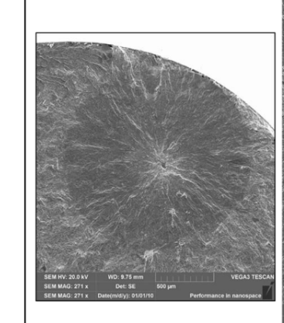
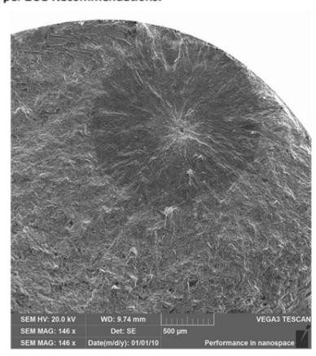
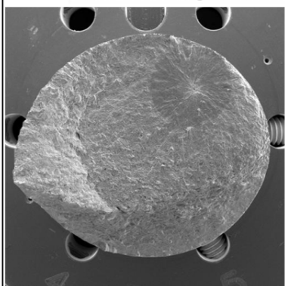
Failure Propagation Phases
Initiation Source
Crack propagation
Final Failure

Slide 5
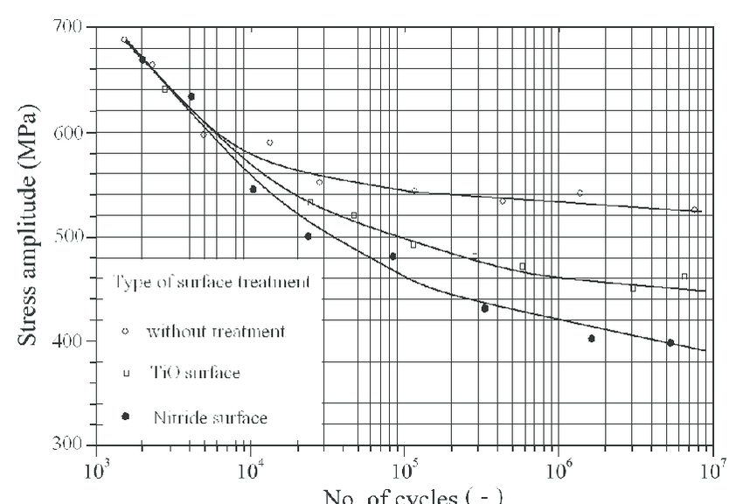
Fatigue Failure

Slide 6
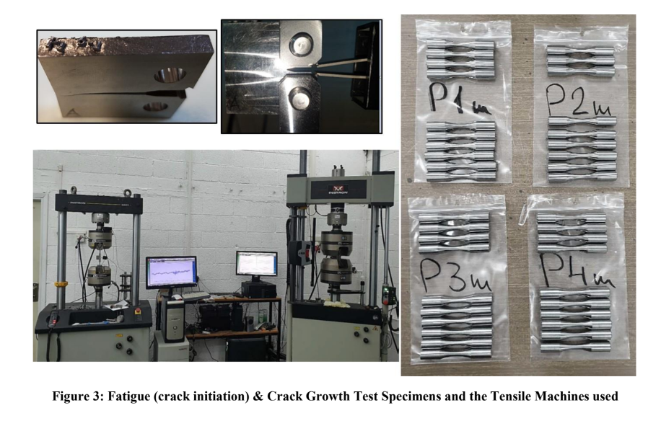
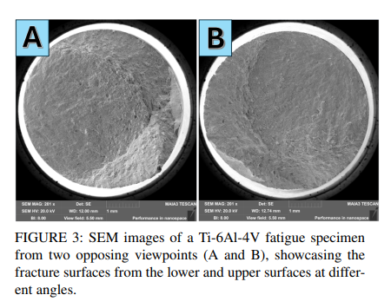
Dataset
The dataset utilized in this research comprises 63 Scanning Electron Microscope (SEM) images of Ti-6Al-4V alloy fatigue specimens.
The dataset is organized into three categories based on the print quality recommended by the manufacturer: P1, P2, P3 …
Included of duplicated images for certain specimens from lower and upper surfaces

Slide 7
AI and Image Processing Approach
Our solution:
Combine image processing techniques and AI to analyze fatigue failure in 3D printed materials.
Key steps: Image Proccesing:
Use sobel operator to detect edges for generate heatmaps for identifying critical features (crack ares).
Preproccesing:
resize and clean Scanning Electron Microscope (SEM) images for uniforn analysis.
AI (Unet model):
Apply UNet architecture for image segmentation.
Detect external contours (whole surface) and internal contours (crack propagation) in fracture surfaces.

Slide 8
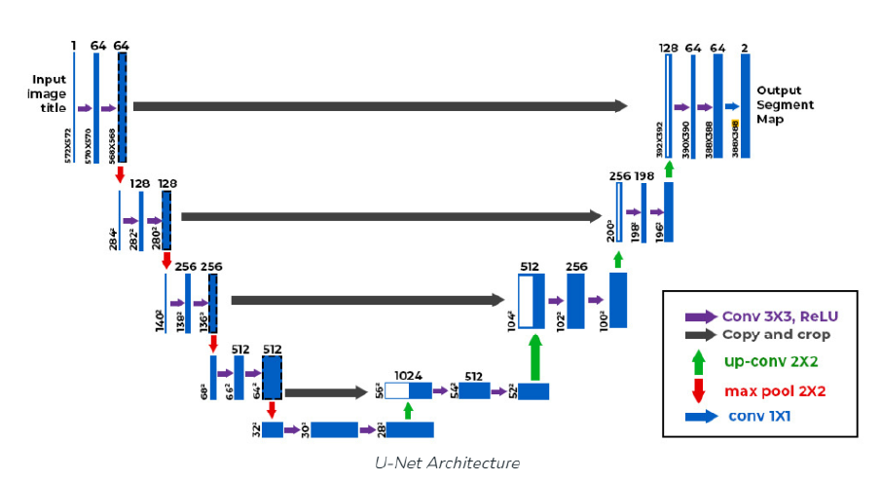
Proposed approach -
U-Net

Slide 9
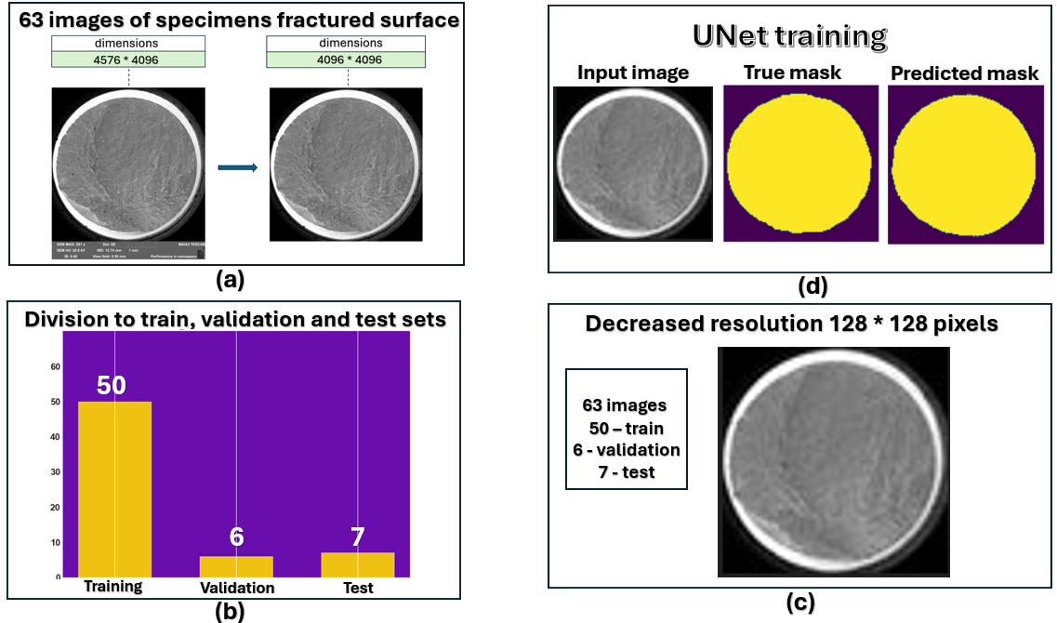
Visualization of the Process

Slide 10
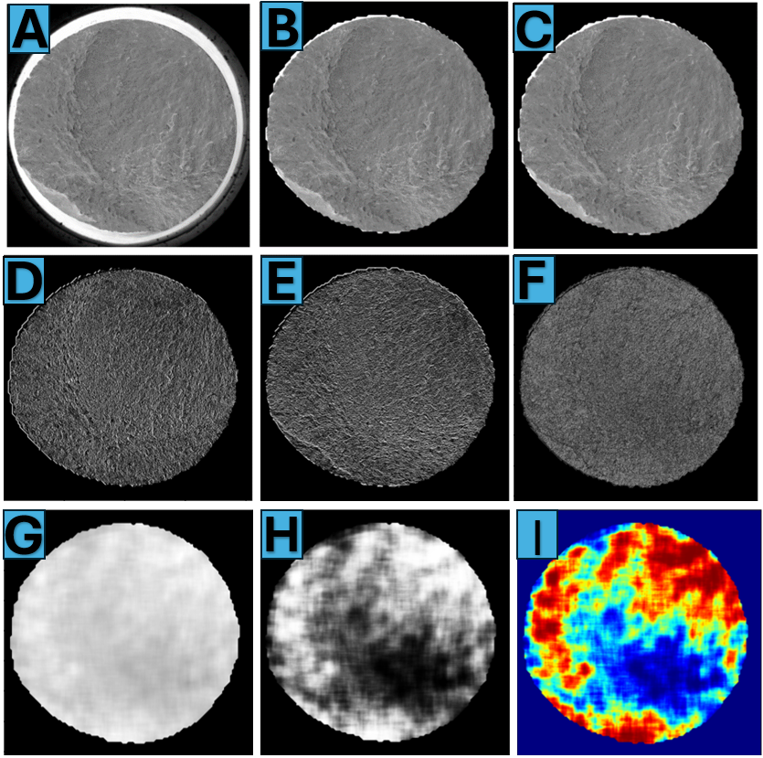
Visualization of the Process-
Heatmap using sobel operator

Slide 11
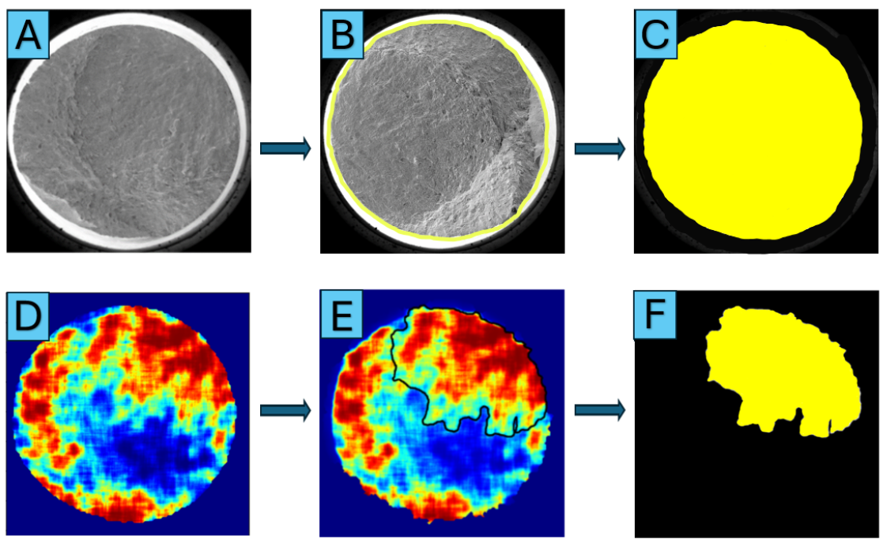
Visulaization of the Process –
Labeling

Slide 12
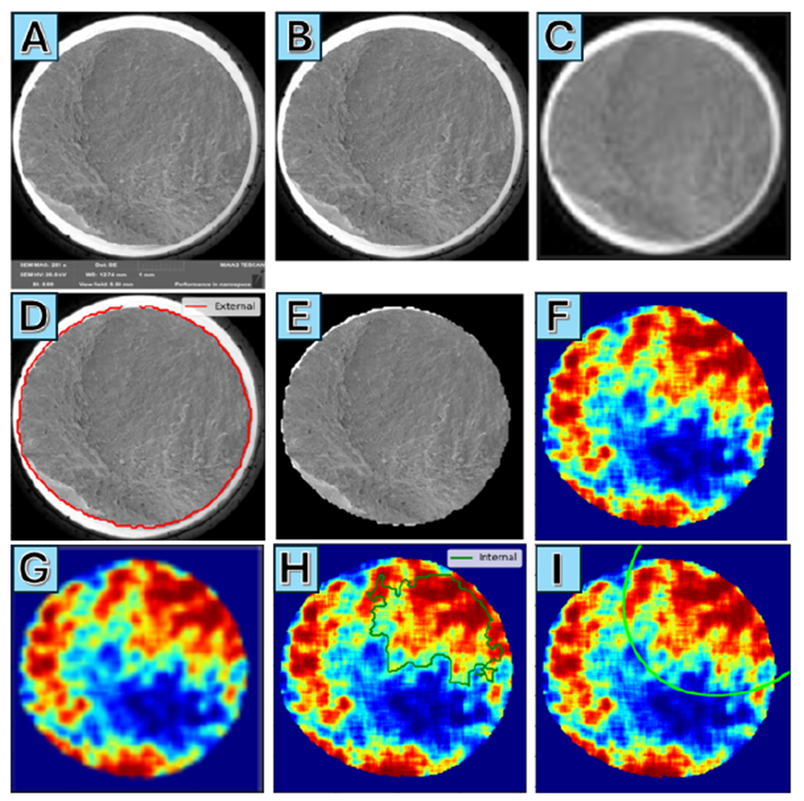
Visualization of the Process –
Get ellipse

Slide 13
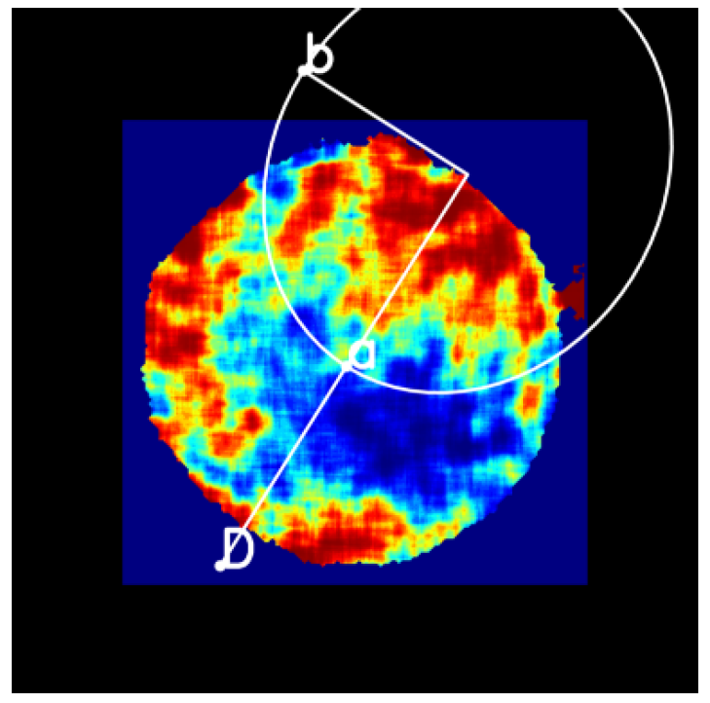
Visualization of the Process –
Get ellipse

Slide 14
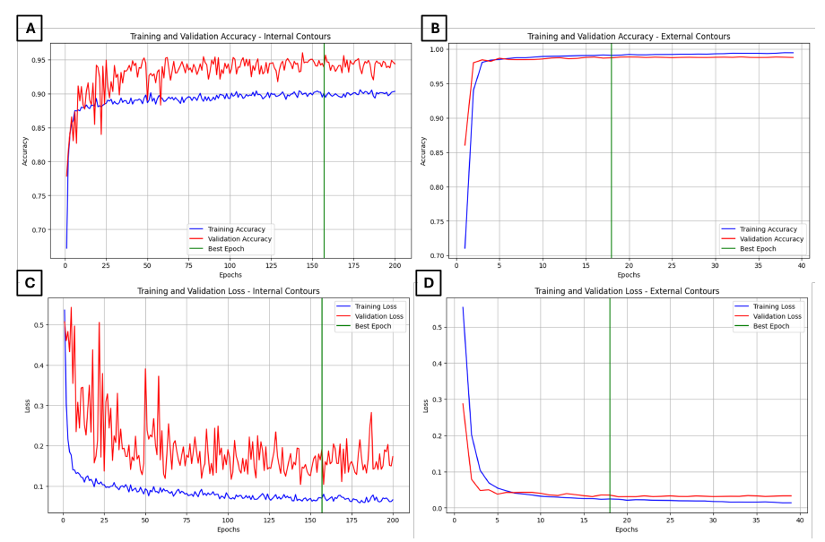
Results
Training and Validation accuracy and loss –
External and internal contours

Slide 15
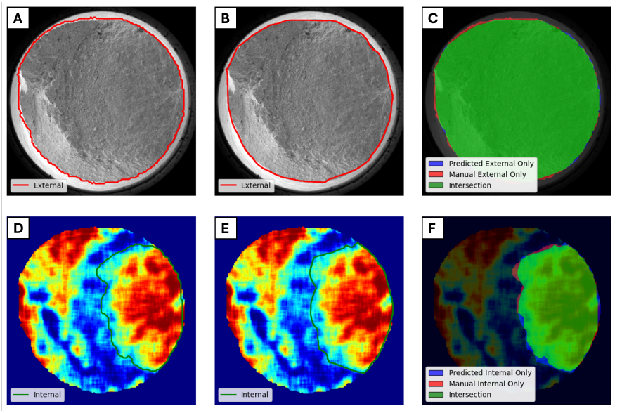
Results
IOU - (Intersection Over Union)
External contour detection achived 0.97 in the IOU.
Internal contour detection achived 0.93 in the IOU.

Slide 16
Conclusion and Future Work
Conclusion:
Developed an AI-driven solution for fatigue failure analysis in 3D printed materials.
Achived high accuracy: IoU of 0.97 for external contour and 0.93 for internal.
Faster and more reliable than traditional manual methods.
Future Work:
Extend the model to analyze other materials and failure types.
Explore real-time monitoring during 3D printing processes.
Investigate additional AI models for even better accuracy and speed.

